Slide 1
CS 1 – Help Session (Week 5)
Warm Up Question: Think about someone learning to ride a bike or play an instrument. Describe the process with a partner, how detailed can you be?

Slide 2
Growth Mindset
By now, hopefully all of you watched the growth mindset video posted in announcements
Discuss:
How does having a growth mindset help with learning CS?
How often do you hear, “I just don’t understand computers” or “I just can’t learn online”
That is a fixed mindset
Yes, the test was hard
But with a growth mindset, you can succeed
The next couple weeks, we are coming back to topics.
We will be going into harder practical’s now
Start *early* (you should have all started on it already)
Work a little each night on them.

Slide 3
Caesar Cipher
Replace each plaintext letter with a different one a fixed number of places down the alphabet.
ABCDEFGHIJKLMNOP….
WXYZABCDEFGHI…
Notes:
TA – Stop at 4:12 – The start of the ‘breaking’ section. It is way more than we need!

Slide 4
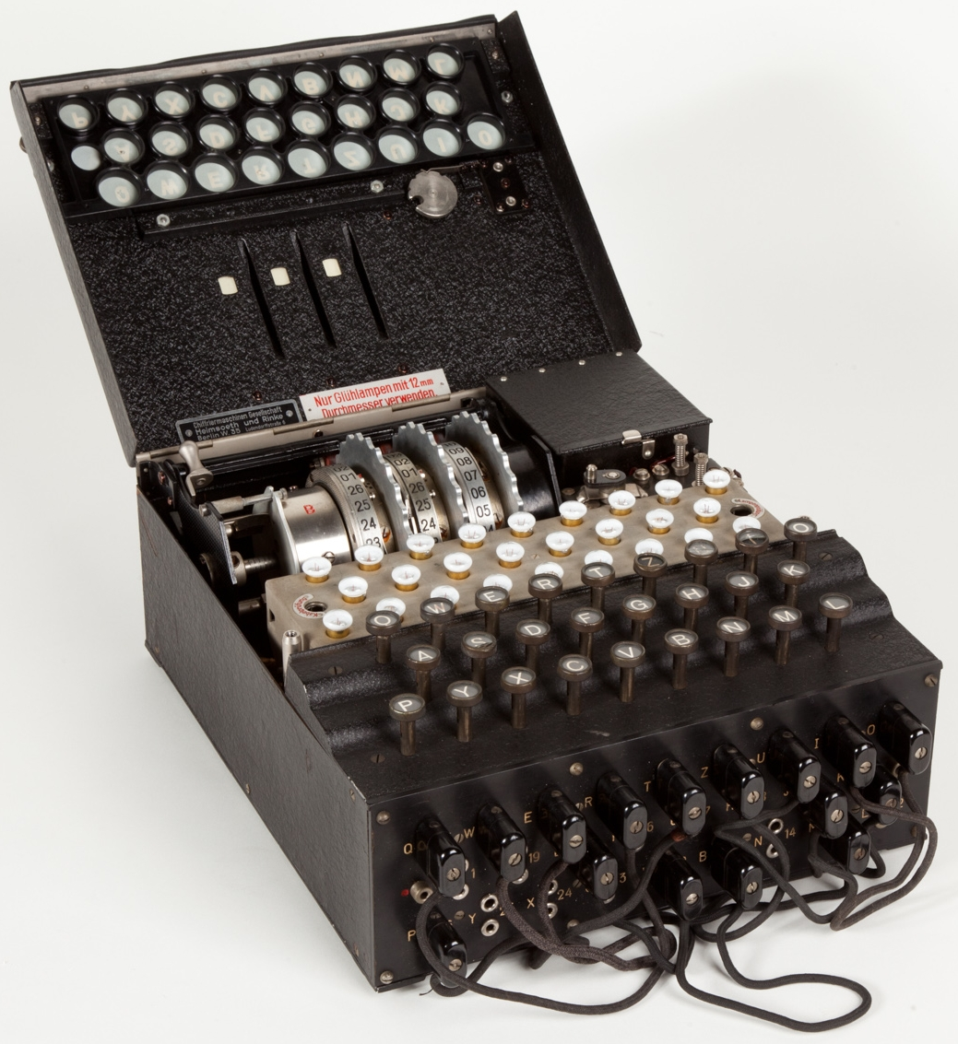
Historic Example
Enigma Machine (Not a Caesar Cipher)
Used in WWII by the German military
3 layered cipher
Randomly set every day
So complex, they could publicly announce the settings will little concern of others overhearing

Slide 5
Code Wise
“abcde….” - is just a String!!
“cdabe…” - is also just a String
What are some useful methods to help you figure out the locations of the letters in the String?
Discuss with a partner
Try to develop an algorithm to solve the substitution cipher with a partner (code is fine)
Notes:
the key one we want them to come up with .indexOf and charAt

Slide 6
Solving it
indexOf(char) --- this method is very helpful! (“Where is it?”)
What does it return?
charAt(int) --- this is also helpful! (“What is it?”)
What does it return?
Algorithm: loop through the message you want to encrypt
for each character, get the indexOf that character in the ‘standard alphabet’ string
Use that index, to get the charAt of that index in the ‘key’
concatenate onto the encrypted string you are generating
Note, if you don’t find indexOf in the Standard Alphabet (space, new line, etc) – don’t change it, just add it by default

